Slide 1
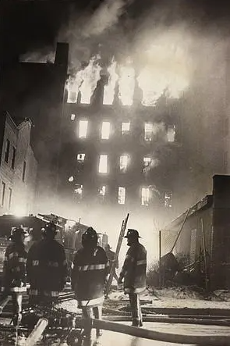
The Bronx is Burning: Urban Disinvestment Effects of the Fair Access to Insurance Requirements
Ingrid Gould Ellen | New York University
Daniel Hartley | Federal Reserve Bank of Chicago
Jeffrey Lin | Federal Reserve Bank of Philadelphia
Wei You | Peking University
The views expressed are those of the authors and do not necessarily represent the views of the Federal Reserve Banks of Chicago, Philadelphia, or the Board of Governors of the Federal Reserve System and its staff.
Notes:
Thanks to the organizers for including our paper in the program. This is joint work with Ingrid Ellen, Jeff Lin, and Wei You. Since Jeff and I work at the Fed, I need to say that these are our views and not necessarily those of the Chicago Fed, the Philly Fed, or the Federal Reserve System.

Slide 2
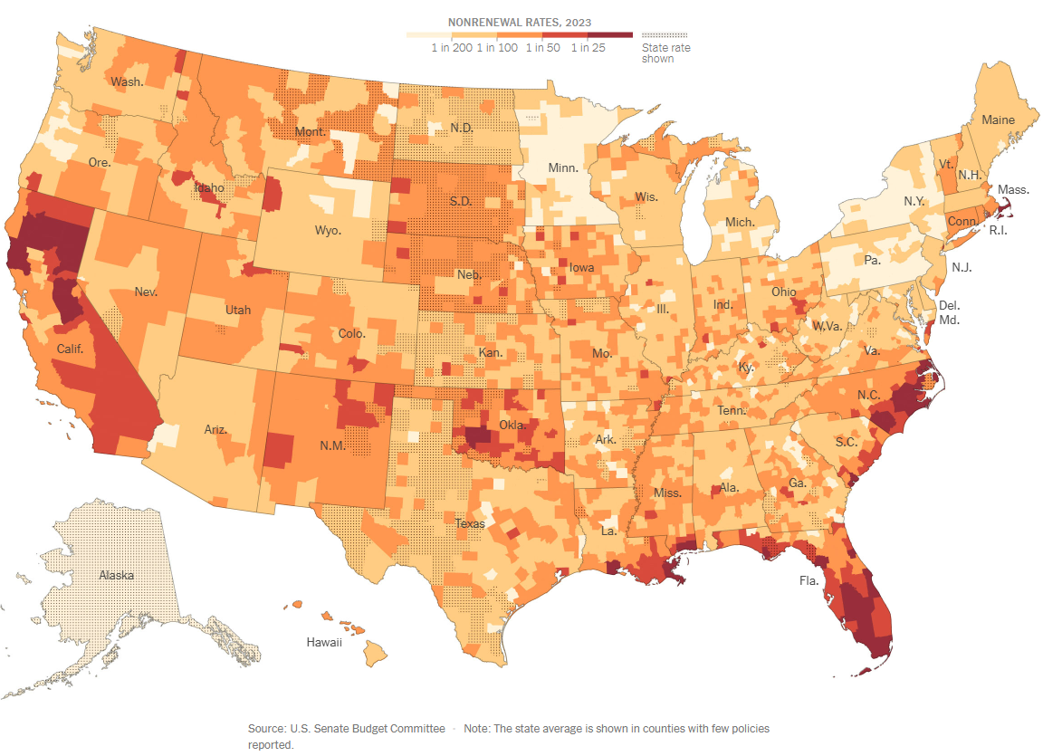
Property Insurance Crisis in 2024
Insurers Are Deserting Homeowners as Climate Shocks Worsen
Without insurance, it’s impossible to get a mortgage; without a mortgage, most Americans can’t buy a home. home.
New York Times Dec. 18, 2024
Notes:
We know there is a property insurance crisis today that is putting stress on state insurance plans.
We are going to investigate another insurance crisis that was itself the origin of these state insurance plans.

Slide 3
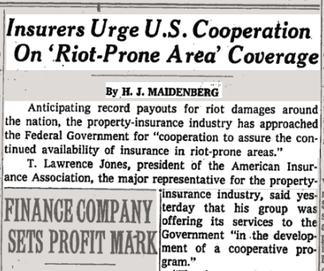
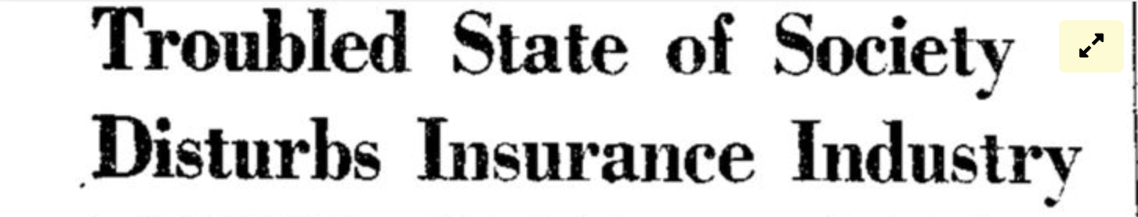
1960s Urban Property Insurance Crisis
After WWII, insurers fled US central cities
By the 1960s, property insurance was expensive, scarce, vulnerable to cancellation.
Fair Access to Insurance Requirements (FAIR)
State residual property insurance offered to property owners without private options.
Implemented by 26 States + DC in the 1960s.
Problematic features:
Prohibited use of environmental or neighborhood factors in underwriting.
Mandatory insurer participation in loss pools diluted underwriting incentives.
Payouts far exceeded market values in declining neighborhoods.
Some blamed FAIR for 1970s arson wave. Others blamed disinvestment in public fire protection.
New York Times, Aug 15, 1967
Columbia Missourian, April 17, 1968
Notes:
Read (but not article tiles)
In response, Congress passed the FAIR access to insurance requirements act,
which authorized states to create public-private, residual property insurance plans to be offered to property owners without private options.
However, they had some features which proved to be problematic: read them.
Then after problematic features, say that “these features combined created incentives for landlords to invest less and possibly actively disinvest in buildings through arson.”
There was a debate at the time: some people at the time thought that FAIR contributed to landlord disinvestment, but others thought the arsons were driven by changes in the provision of firefighting services.

Slide 4
Research Question 🧐
What were the effects of FAIR plans on housing and neighborhoods?
Challenges
Measurement of exposure to FAIR.
Identifying appropriate counterfactual.
Our approach
City directories measure post-war reductions in insurance access.
Triple-difference design.
Notes:
Our key question is whether these FAIR insurance plans accelerated arson, housing disinvestment and demographic change in urban neighborhoods.
The challenges to answering this questions are:
Difficulties in measuring exposure to FAIR plans
Identifying the appropriate counterfactual
Our approach addresses these challenges in the following ways:
We use city directories to measure post-war reductions in insurance access to identify neighborhoods that were likely eligible for FAIR
We employ a triple difference design in which an analysis of pre-treatment trends provides corroborating evidence of the appropriateness of the counterfactual

Slide 5
What We Do 🔬🔎
Triple-difference design
Naïve comparison of properties and neighborhoods with & w/o FAIR is infeasible (no policy microdata) and confounded (by owner & property factors in eligibility, take-up).
(1) Pre/post FAIR, (2) Neighborhoods with/without likely FAIR access, (3) Participating/non-participating States.
Symmetric analysis of participating (early-FAIR) and non-participating States (i) controls for confounding differences across neighborhoods and (ii) addresses endogenous (unobserved) take-up.
We estimate ITT effects.
Notes:
A Naïve comparison of properties and neighborhoods with & w/o FAIR is infeasible (no policy microdata) and confounded (by owner & property factors in eligibility, take-up).
So, instead we use a triple difference design, differencing by:
Pre/post FAIR time period,
(2) Neighborhoods with/without likely FAIR access,
(3) Participating/non-participating FAIR States.
Symmetric analysis of participating (early-FAIR) and non-participating States:
controls for confounding differences across neighborhoods (unobserved neighborhood characteristics)
addresses endogenous (unobserved) take-up (unobserved property characteristics).
(By adding the cross-state comparison, we are addressing both neighborhood confounders and property-level confounders.)
Since we do not observe actual FAIR policy use, we estimate intent to treat effects

Slide 6
Results 🔥 🏚️ 📉
Design of early FAIR plans reduced incentives to invest in housing maintenance, which led to declines in stock of pre-war housing units in FAIR-affected tracts
Estimated ITT effect of -313 (-30%) pre-war housing units, mostly in 1970s.
Or about 45% of the loss of pre-war housing units from 1960-1980
Concentrated in multi-family structures and renter-occupied units.
Quantitatively matches (new) evidence on building fires.
FAIR disinvestment led to significant neighborhood change
Declines in neighborhood population and income.
Increased Black population share & accelerated racial transition.
Total effects include direct and indirect effects (through spillovers).
Notes:
Read bullets.
Add Callback on bullet 2: Consistent with FAIR affecting the incentives for landlords but not necessarily owner occupiers.

Slide 7
Contributions 1
Effects of FAIR Plans
Mostly historical, legal analyses to date (Ansfield, 2021; Dwyer, 1978; Works, 1977)
We estimate causal effects for a broad set of cities
Central neighborhood decline and change
White flight (Boustan, 2010), blockbusting (Hartley and Rose, 2023)
Urban unrest (Collins and Margo, 2007; Brooks et al., 2022)
We identify a channel through generosity of FAIR plans.
Role of housing disinvestment (Cornelissen and Jang-Trettian, 2023)
The other side of the “doom loop”: Housing disinvestment → neighborhood decline.
Notes:
First, and most directly, the paper speaks to the existing research on FAIR Plans, which tends to come out of the law and history literatures.
Second, we contribute to the body of research on urban neighborhood decline by highlighting the role of insurance in housing disinvestment and neighborhood decline.
Specifically, we identify the other side of the doom loop, the effect of housing disinvestment on neighborhood decline.

Slide 8
Contributions 2
Market failures in insurance markets
Moral hazard in health insurance (Finkelstein, 2014)
Moral hazard in auto insurance (Weisburd, 2015)
Moral hazard from house price declines (Eriksen and Carson, 2017)
We study moral hazard from property insurance design.
Notes:
Third, our paper connects to a broader literature on insurance and moral hazard by offering new, causal estimates of the extent to which insurance availability and payout generosity can distort behavior

Slide 9
Roadmap 🛣️
Introduction
Historical Background
Data and Methods
Results

Slide 10
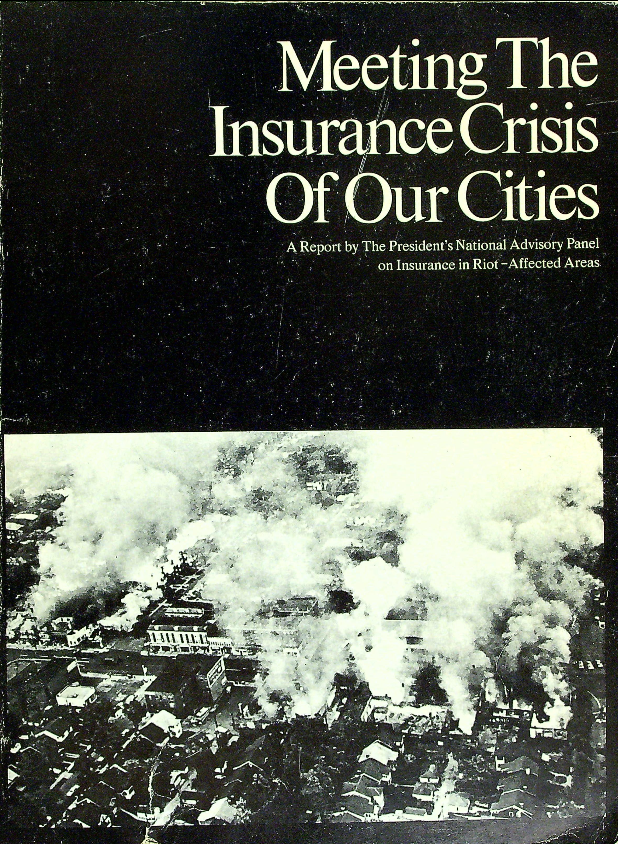
Historical Context 📜
Hughes Panel (offshoot of Kerner “Riot” Commission)
“Long hot summer” of 1967.
National Advisory Panel on Insurance in Riot-Affected Areas of August 1967.
Panel recommended FAIR plans; Became law August 1968.
FAIR plans
Modeled on Boston Plan of 1960 & 13 early State plans.
26 States + DC began issuing FAIR policies 1968-1970.
300k+ policies in 1969, 2.7M+ by 1972, 5.7M+ by 1977.
“
One of the most urgent needs in America’s cities today is to assure that the property of businessmen and homeowners is adequately protected by insurance.
President Johnson, Jan 27, 1968
Notes:
In response to growing concerns about this withdrawal of insurance, President Johnson established the Hughes Panel (an offshoot of the more famous Kerner Commission).
Upon the release of the panel’s report, President Johnson underscored the urgency of congressional action by declaring the continued availability of property insurance as one of the most “urgent needs” in America’s cities.
The panel’s report documented the difficulty property owners faced in obtaining insurance in central, lower income neighborhoods and pointed to explicit redlining by insurance companies.

Slide 11
Design & Establishment of FAIR Plans
FAIR plan features
Prohibited use of environmental or neighborhood factors (“beyond property owner’s control”) in underwriting.
Mandatory insurer participation in loss pools diluted incentives for prudent underwriting.
Payouts far exceeded market values in declining neighborhoods.
States had to choose to participate
Feds offered “carrot” of federal riot reinsurance.
Early FAIR States: 18 States + DC in 1968, 26 States + DC by 1970.
Other States did not participate until 1986 at earliest, or never.
Notes:
With bipartisan support, Congress almost immediately adopted the recommendations of the panel and authorized these plans through the Urban Property Protection and Reinsurance Act of 1968. Federal guidelines barred plans from considering environmental hazards or conditions that were beyond the control of the property owner in appraising property risk. While Congress enacted these plans, states had to agree to adopt them, and Congress offered the carrot of reinsurance to incentivize participation.

Slide 12
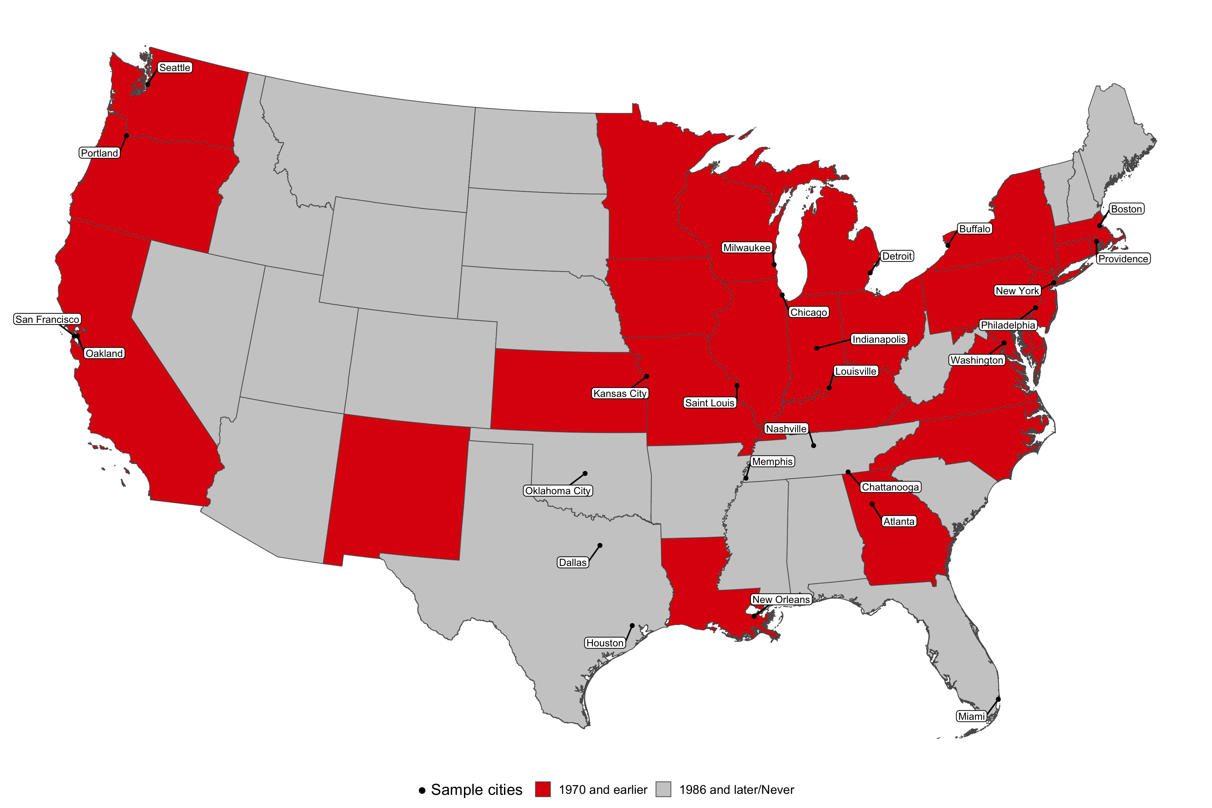
Early-FAIR States & Sample Cities
Notes:
This map shows the early FAIR adopting states by 1970 in red and all other states in gray which either never adopted or did so in 1986 or later. The cities in our sample are also indicated.

Slide 13
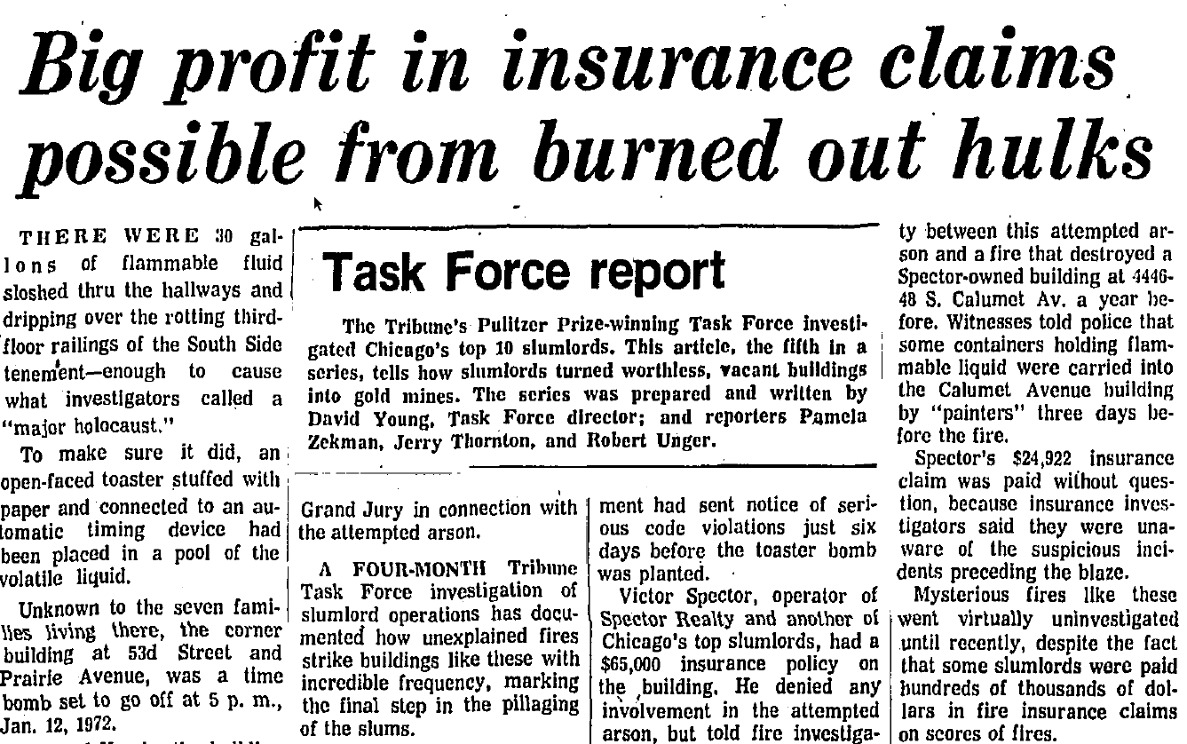
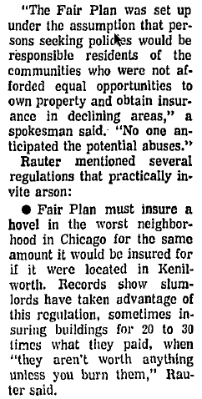
Unintended Consequences: Contemporary Coverage & Debate 📰
Chicago Tribune, 1973
Notes:
The FAIR incentives for landlord disinvestment (including arson) were noticed by contemporary accounts including this Tribune article from 1973.
Could read “Witnesses noticed…”
Shows the difficulty in investigating arson.

Slide 14
Roadmap 🛣️
Introduction
Historical Background
Data and Methods
Results

Slide 15
What We Do 🔬🔎
Triple-difference design
(1) Pre/post FAIR,
(2) Neighborhoods with/without likely FAIR access,
(3) Participating/non-participating States.
Notes:
The first difference is to compare pre/post FAIR (1960 and before to 1970 and after)
The second comparison is neighborhoods with and without likely FAIR access. Of course, neighborhoods with likely access to FAIR are different than neighborhoods that had stable or increasing access to private insurers
The third difference is to compare early FAIR participating and non-participating states. This difference is key for identification, because it helps control for both neighborhood-level confounders and property-level confounders
Back to point 2, we are unable to measure where FAIR plans were actually written, and using that measure would be endogenous

Slide 16
Neighborhoods with likely FAIR access
Measure neighborhoods where property owners likely to have been offered FAIR plans
Neighborhoods that saw declining access to property and casualty insurance establishments between 1940 and 1967
We measure insurer withdrawal in both early-FAIR States that offered FAIR plans in the 1960s and non-participating states that did not.
Placebo treatment
Post-war declines in access to lawyers.
Notes:
We can’t observe where FAIR plan policies were written, so instead, we measure treatment by private insurer withdrawal, to indicate neighborhoods where property owners would have had to have turned to new FAIR plans, to identify an intent-to-treat effect. Specifically, we identify neighborhoods that saw declining access to property and casualty insurance establishments from 1940 to 1967.
People tended to buy insurance locally in these years from agents in their neighborhoods, so that this withdrawal left a gap in access to insurtance.
Repeat identifying assumption and explain why we think this solves the identification problem. The difference between an insurare withdrawal neighborhood and a stable or increased access
We cant just compare places that got FAIR plans to places that did not
Instead we make the contrast withing cities of neighborhoods where FAIR plans were and were not likely available and compare this to the same contrast in cities where non FAIR plans were available.
We also consider a placebo treatment using declines in access to lawyers/law firms.

Slide 17
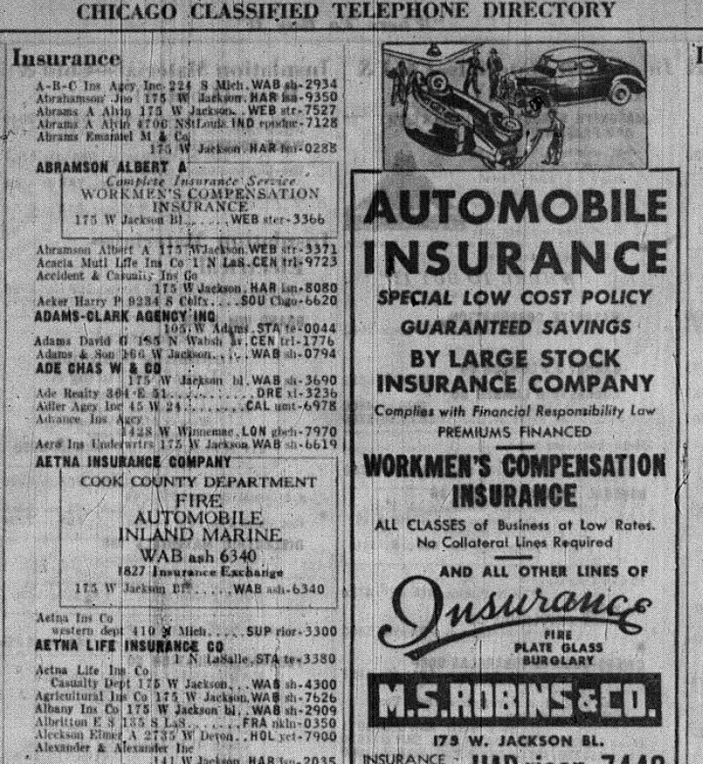
Insurer (and Lawyer) Data from City Directories
City Directories and Yellow Pages
26 major cities in early-FAIR & non-participating states.
Two snapshots, ~1940 & ~1967.
Notes:
To get the location of insurance companies, we digitized sections of city directories in roughly 1940 and 1967 for 26 large U.S. cities.
The image shows a page from the insurance section from Chicago in 1940

Slide 18
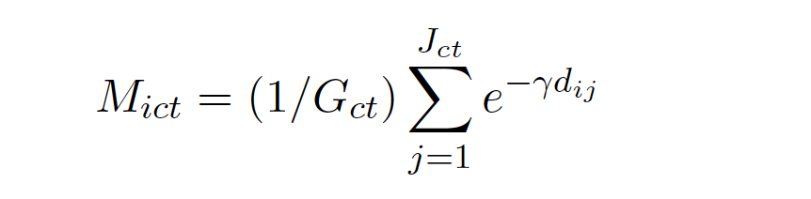
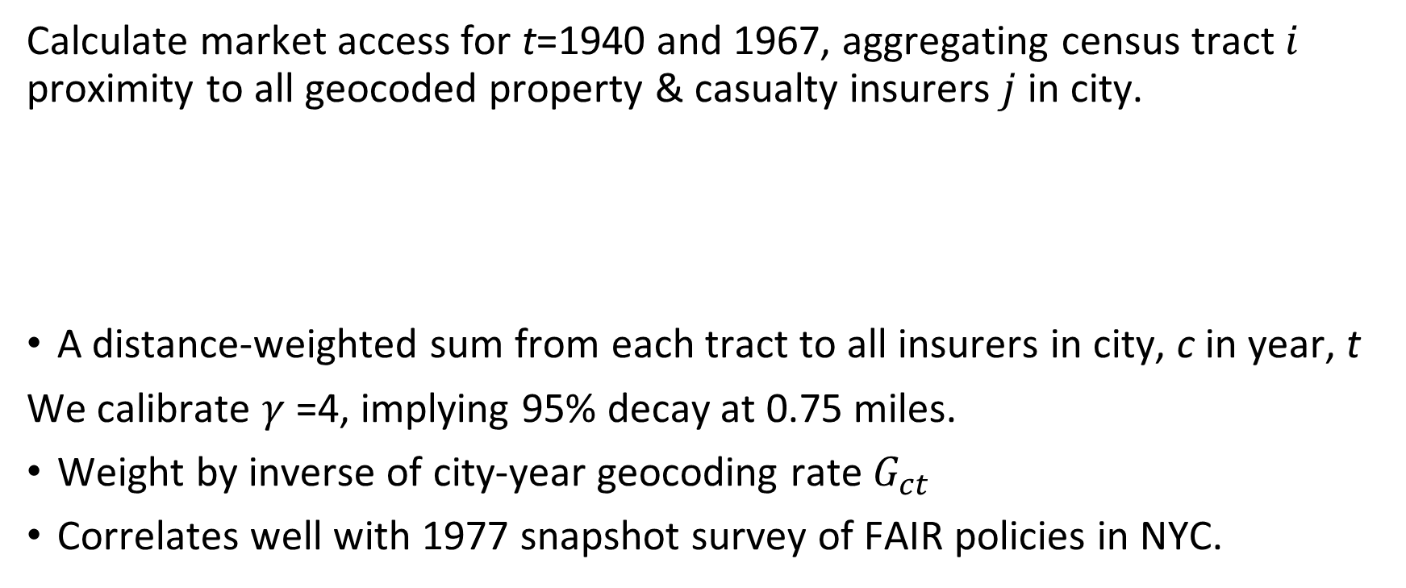
Measuring Declining Market Access
Calculate market access for t=1940 and 1967, aggregating census tract $i$ proximity to all geocoded property & casualty insurers $j$ in city.
A distance-weighted sum from each tract to all insurers in city, c in year, t
We calibrate $γ$=4, implying 95% decay at 0.75 miles.
Weight by inverse of city-year geocoding rate $G_{ct}$
Correlates well with 1977 snapshot survey of FAIR policies in NYC.
Notes:
We compute a simple measure of access to insurers for every tract in each year.
Our results are robust to doing this in a number of different ways.
Our resulting measure is also strongly correlated with snapshot 1977 measure of FAIR plan use in NYC neighborhoods.

Slide 19
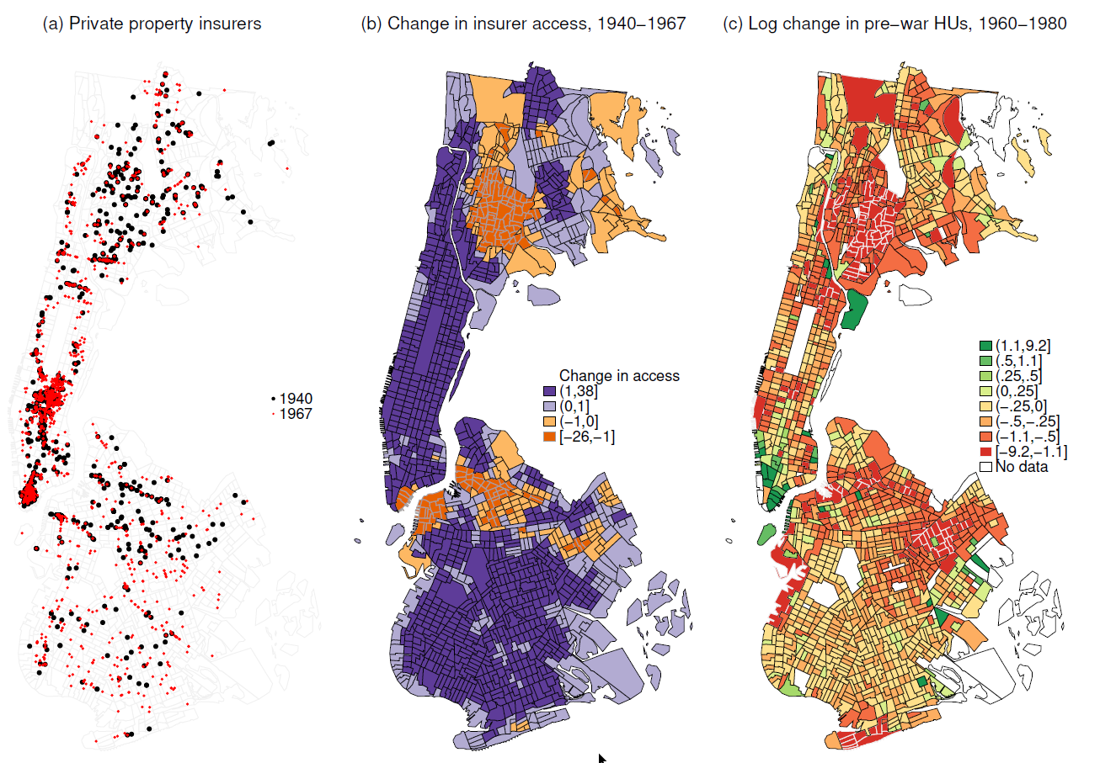
Notes:
The maps show the Bronx, Manhattan, and Brooklyn.
Left map shows property insurer locations in 1940 (black) and 1967 (red).
Center map shows considerable variation in treatment status across neighborhoods, even at the same distance from the CBD. The orange areas are our treated neighborhoods, which lost access to insurance companies between 1940-1967, while the purple experienced stable or increased access.
Suggestively, in the right map we see, in red, large decline in pre-war housing units, between 1960 and 1980 in the same neighborhoods that were treated by declines in insurer access, especially the south Bronx and northern Brooklyn.

Slide 20
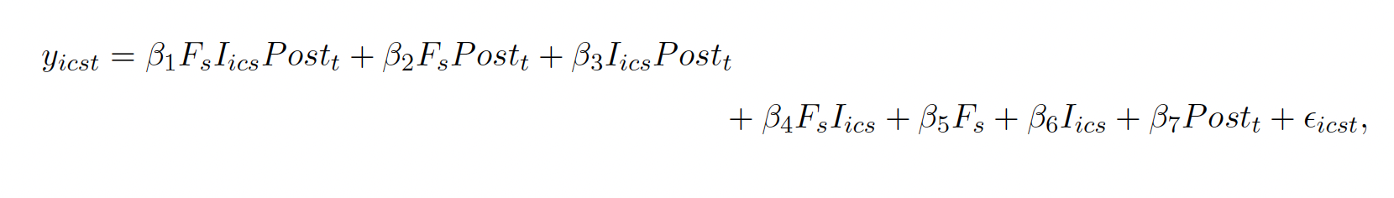
Triple-Difference Specification
Additional Specifications:
Census tract fixed effects
Allow neighborhood characteristics to have time-varying effects
1950-60 Change in Log Population * 1{t}
1950-60 Change in Percent Black * 1{t}
Notes:
The equation shows the simplest triple-difference specification.
The second specification adds census tract fixed effects.
The third specification replaces the census tract fixed effects with interactions of pre-trends in log population and the Black population share from 1950-1960 with indicators for the census decade.
We prefer the third specification because it allows us to flexibly control for both pre-trends in population and racial composition.
This should address concerns that we are simply picking up the continuation of changes that were already happening in neighborhoods where insurance became less available.

Slide 21
Neighborhood Data
Consistent-boundary census tract panel 1950–1990 (Lee and Lin, 2018)
Total prewar housing units (year built<1940)
Total housing units, by tenure, by structure type (MF vs SF)
Population, by race
Average household Income
Average gross rent
Average years of education
Sample: Balanced panel of ~6,000 tracts in 26 cities, five decennials
Notes:
Read bullets

Slide 22
Treatment & Comparison Groups
 | Neighborhoods | Percent
Reduced access, Early FAIR State | 965 | 16%
Stable access, Early FAIR State | 3,899 | 65%
Reduced access, Late FAIR State | 240 | 4%
Stable access, Late FAIR State | 872 | 15%
Total | 5976 | 100%
Notes:
Our final sample is just under 6,000 census tracts.
The sample is somewhat skewed towards tracts in cities in early FAIR states.
But about a fifth of our sample tracts are in late FAIR states.

Slide 23
Roadmap 🛣️
Introduction
Historical Background
Data and Methods
Results

Slide 24
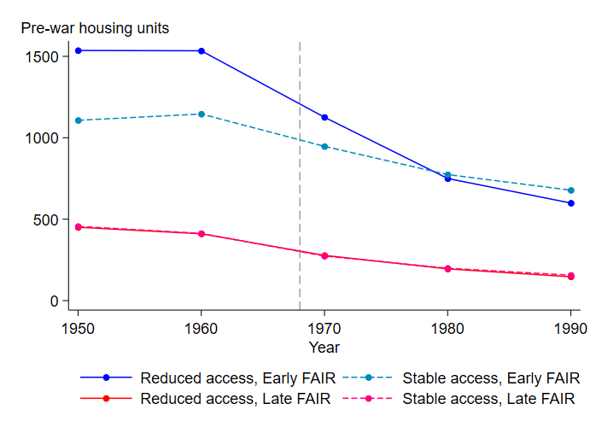
Disinvestment in Housing
Housing units built 1940 & earlier
By year, and
By treatment & comparison groups.
Notes:
The figure shows the raw tract-level means of the number of pre-war housing units in each decade by the treatment and comparison groups.
The treated group with reduced insurance access in Early FAIR states is shown by the blue solid line
The means of the stable access neighborhoods in Early FAIR states is shown in the blue dotted line.
The solid blue line shows a much steeper drop in housing units than the dotted blue line.
The red solid and dashed lines lie on top of each and show roughly similar declines as the blue dotted line.
These raw means paint the basic picture of a much large loss of pre-war units in neighborhoods with likely access to FAIR policies in FAIR states.
Raw differences in trends in the number of pre-war housing units. The upper two lines compare trends in stable and reduced access tracts in early FAIR states. Effects start to emerge by 1970, but not surprising given that 90 percent of treated tracts in our sample are in states that launched FAIR plans and started issuing policies in 1968. Take-up was accleterated in part because between 1965 and 1967, 13 states had created residual property insurance plans, called Urban Area Plans, which became the blueprint for FAIR plans. The presence of these plans does not affect our research design, as we compare outcomes in 1960 and earlier with those in 1970 and later. By contrast, we see little difference in trends between reduced and stable access tracts in late FAIR states.

Slide 25
Triple Difference Estimates
Pre-war Housing Units | Insurers | Insurers | Insurers
1(reduced access) | -382.3*** | -382.9*** | -312.5***
*1(early FAIR)*1(after 1970) | (71.6) | (71.1) | (73.1)
City-Year FEs |  | X | X
Tract FEs |  | X
Interactions with decade: (change in log population, 1950-60) (change in Black share, 1950-60) |  |  | X X
N | 29,726 | 29,726 | 29,726
R2 | 0.167 | 0.843 | 0.248
Notes: Standard errors clustered by city.
Notes:
These basic findings hold up in regressions.
The coefficient on triple diff for our preferred specification in column 3 suggests that the introduction of FAIR plans was associated with an average loss of about 313 pre-war housing units per census tract in neighborhoods that lose access to property and casualty insurers between 1940-1967.
This is about 30 percent of the pre-treatment mean.

Slide 26
Triple Difference Estimates: Lawyer Placebo
Prewar HUs | Insurers (Lawyer sample) | Lawyers
1(reduced access) | -349.3*** | -84.2
*1(early FAIR)*1(after 1970) | (147.9) | (104.8)
City-Year FEs | X | X
Tract FEs
Interaction with decade: (change in log population, 1950-60) (change in Black share, 1950-60) | X X | X X
N | 24,024 | 24,024
R2 | 0.216 | 0.212
Notes: Standard errors clustered by city.
Notes:
In contrast, we see no significant impact of declining access to lawyers on pre-war housing units.
Our results do not capture unobserved factors associated the with general withdrawal of professional services from treated neighborhoods

Slide 27
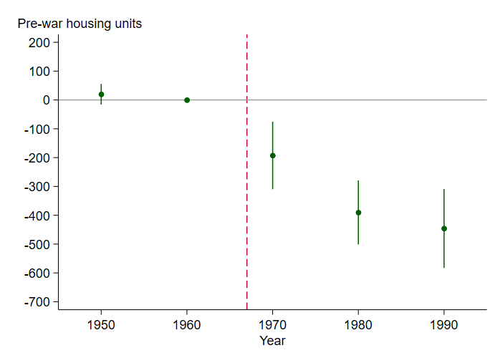
Event Study Estimates
Change since 1960 in prewar HUs
Spec 3 controls:
1950-1960 changes in log population, Black share * 1{t}
Timing:
90% of dynamic effect by 1980, when reforms allowed for stricter FAIR underwriting.
Notes:
To show the dynamics of this treatment effect, we show an event study specification in which we interact triple difference with each of the year dummies.
We see effects emerge immediately after the policy change, and then they grow during the 1970s.

Slide 28
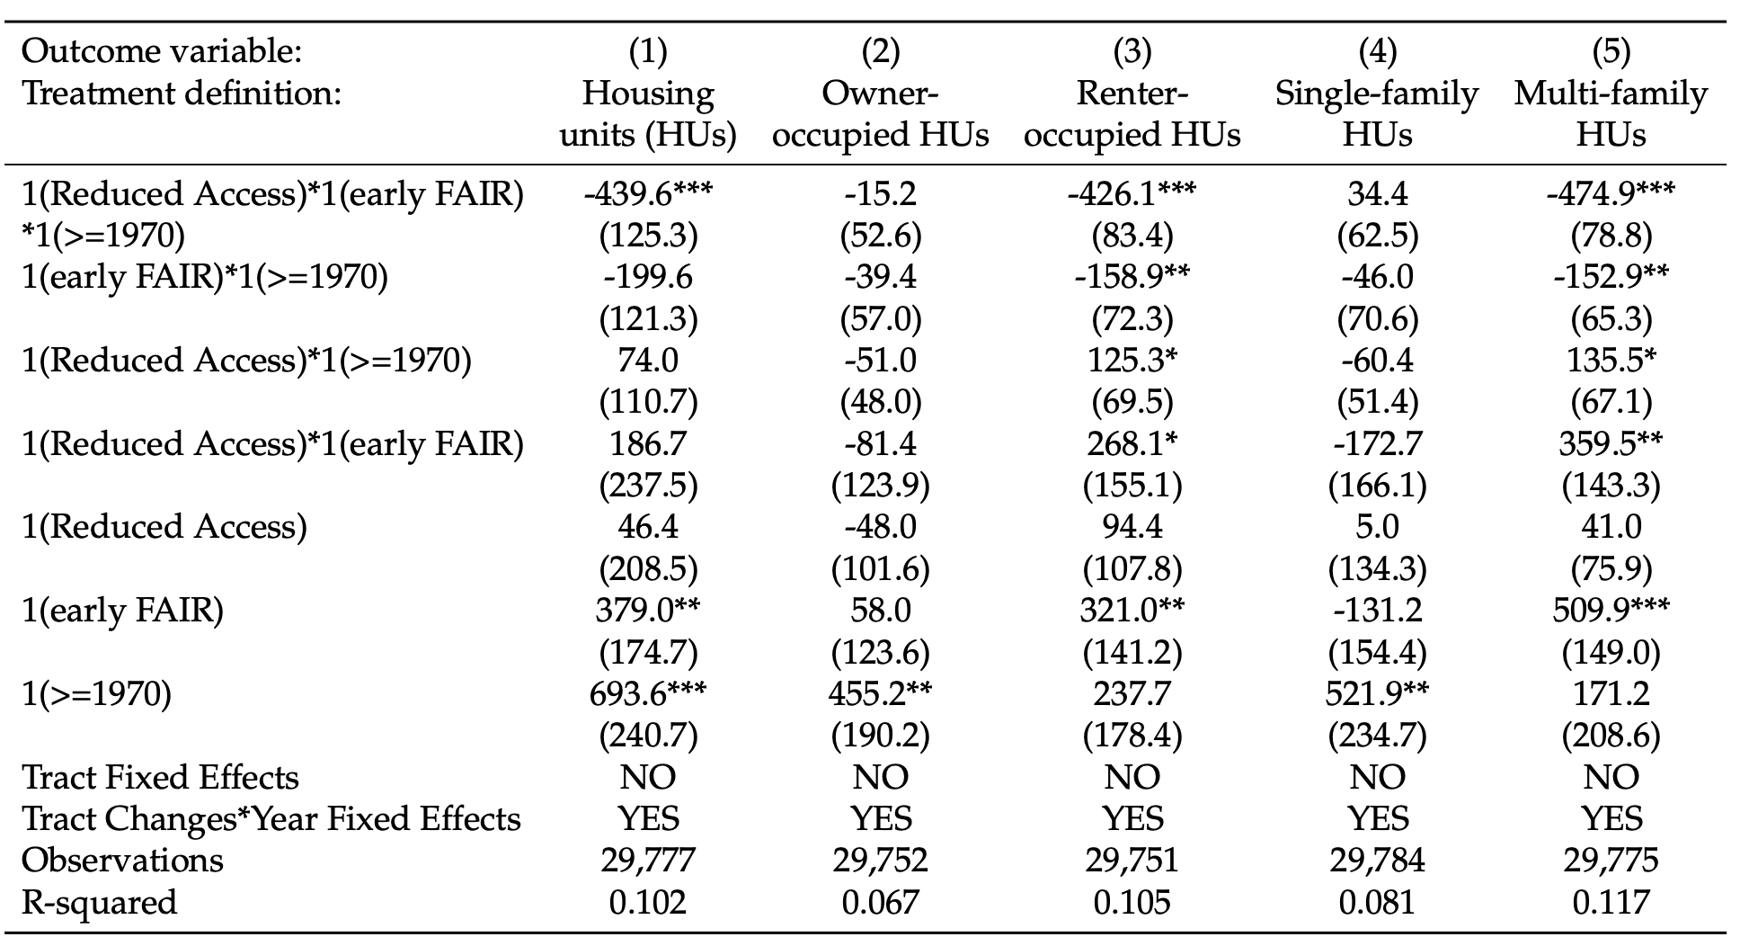
Negative Effects for Rentals & Multi-Family
Negative effects for:
Renter-occupied housing units
Housing units in MF structures
Null effects for:
Owner-occupied housing units
Single-family housing units
Notes:
The effects are driven by renter occupied housing units and housing units in multi-family structures.

Slide 29
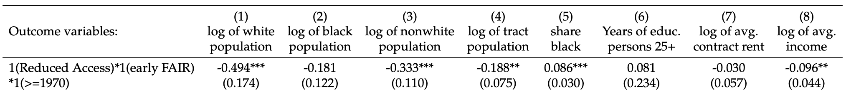
Neighborhood Racial Transition and Decline
Significant effects on neighborhoods:
Increased Black share, decreased population, decreased income.
Total effects incorporating both direct effects on neighborhood QOL and sorting and indirect effects operating through spillovers.
Notes:
Read bullets
These effects show the other side of the doom loop, showing that housing disinvestment can cause decreased neighborhood population and income

Slide 30
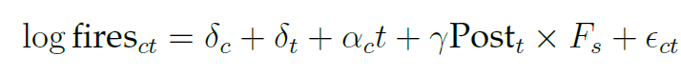
Suggestive Evidence from City-Level Fires
Building fires
We hand-annotated annual city-level building fire surveys 1938-1978. NFIRS 1980-1988.
Regression of fires in 43 FAIR non-FAIR cities:
Results
DD estimate: 32% more building fires in early-FAIR states after 1968.
This result is mainly driven by 1968-1980 period, post-1980 magnitude is roughly half the size and not statistically different from zero
Pre-trends look good, small magnitude and not statistically significant
Back-of-the-envelope calculation: 200-300 building fires per tract per decade
Notes:
We collected annual building fire data
This is a diff-indiff at the city level comparing city level fires in early FAIR and late FAIR states
The DD esdtimate is 32% more building fires in early-FAIR states after 1968
That corresponds to about 200-300 building fires per tract per decade which is comparable to the number of pre-war housing units lost in this period

Slide 31
Other Results and Robustness
Pre-trends analysis
1950-60 trends in 11 factors and 1940-50 trends for available subsample.
Robustness
Different definitions of treatment.
Validation using 1977 FIA survey of FAIR plans.
Sensitivity to outlier cities.
Notes:
Our result sare robust to different measures or treatment.
Pre-trend analysis looks good and validates our identifying assumptions

Slide 32



Summary
Housing disinvestment
Neighborhood change
Conclusions
1960s FAIR plans led to disinvestment in housing.
FAIR plans also accelerated neighborhood racial transitions and declines in population and income.
Cautionary lesson in designing insurance policy.
Fairness in access is important, but over-insurance can backfire.

Slide 33
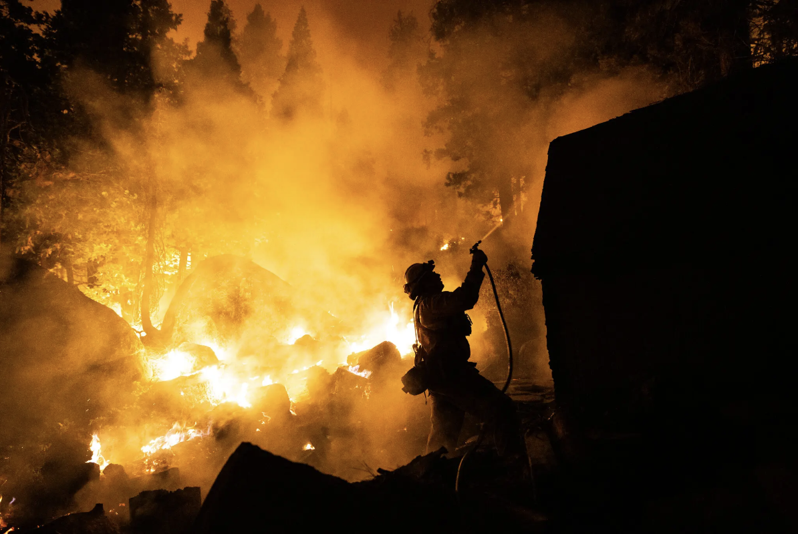
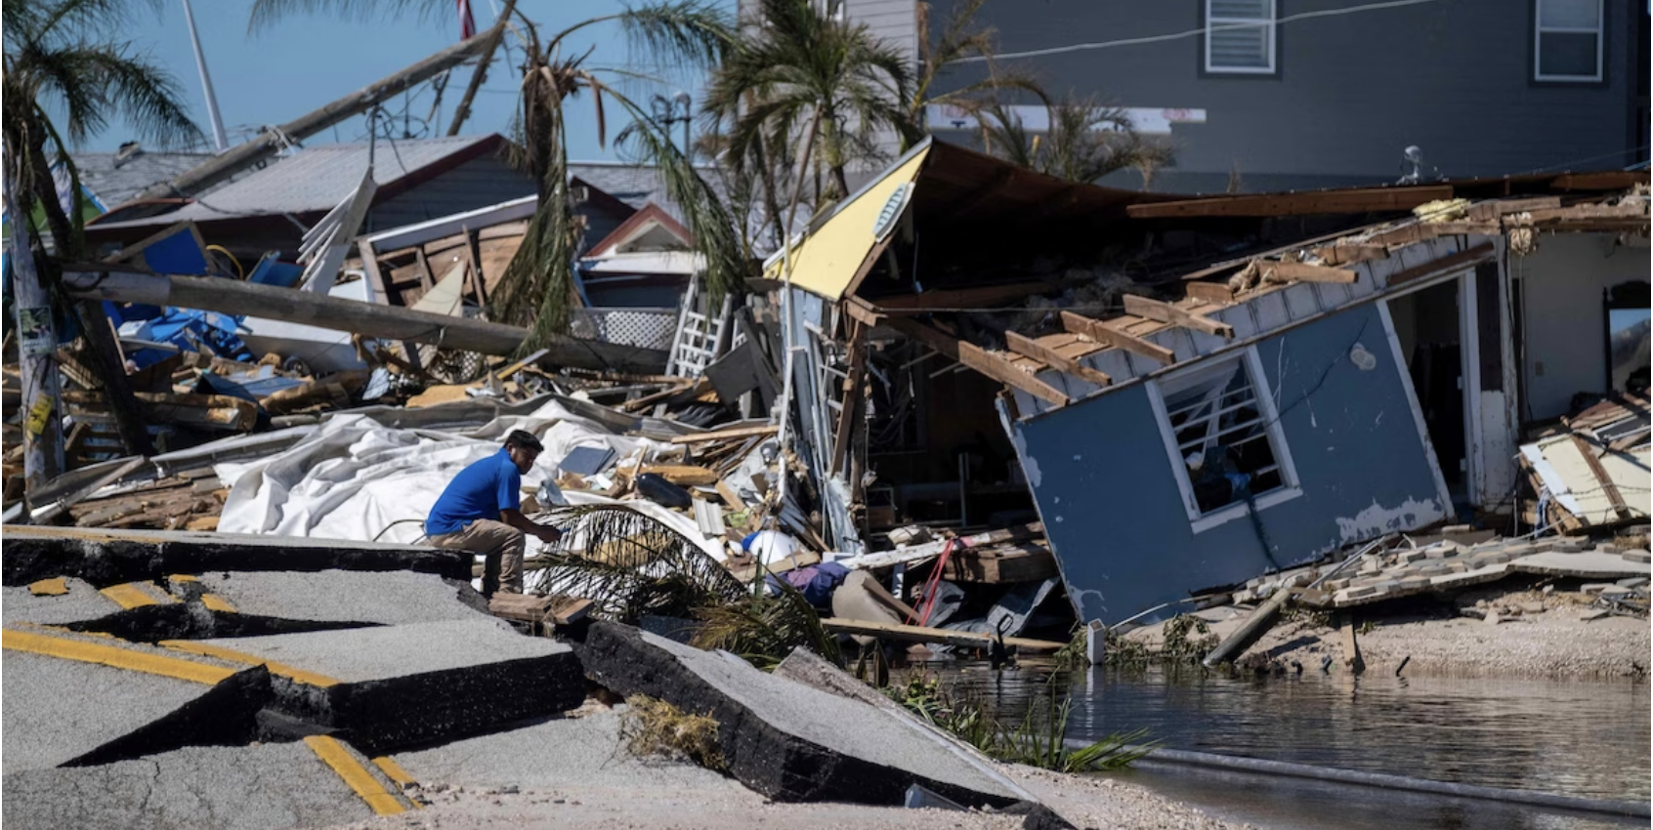
Property Insurance Crisis in 2024
Homeowners struggle to find, afford insurance
amid California's crisis, KCRA, Feb 26, 2024
Florida Insurance Crisis Spells Mortgage Disaster
Newsweek, Jan 22, 2024
Notes:
It seems that every month there is a new announcement about a property insurer pulling out of a market because of fears about intensifying climate threats, especially in California and Florida.

Slide 34
Appendix

Slide 35
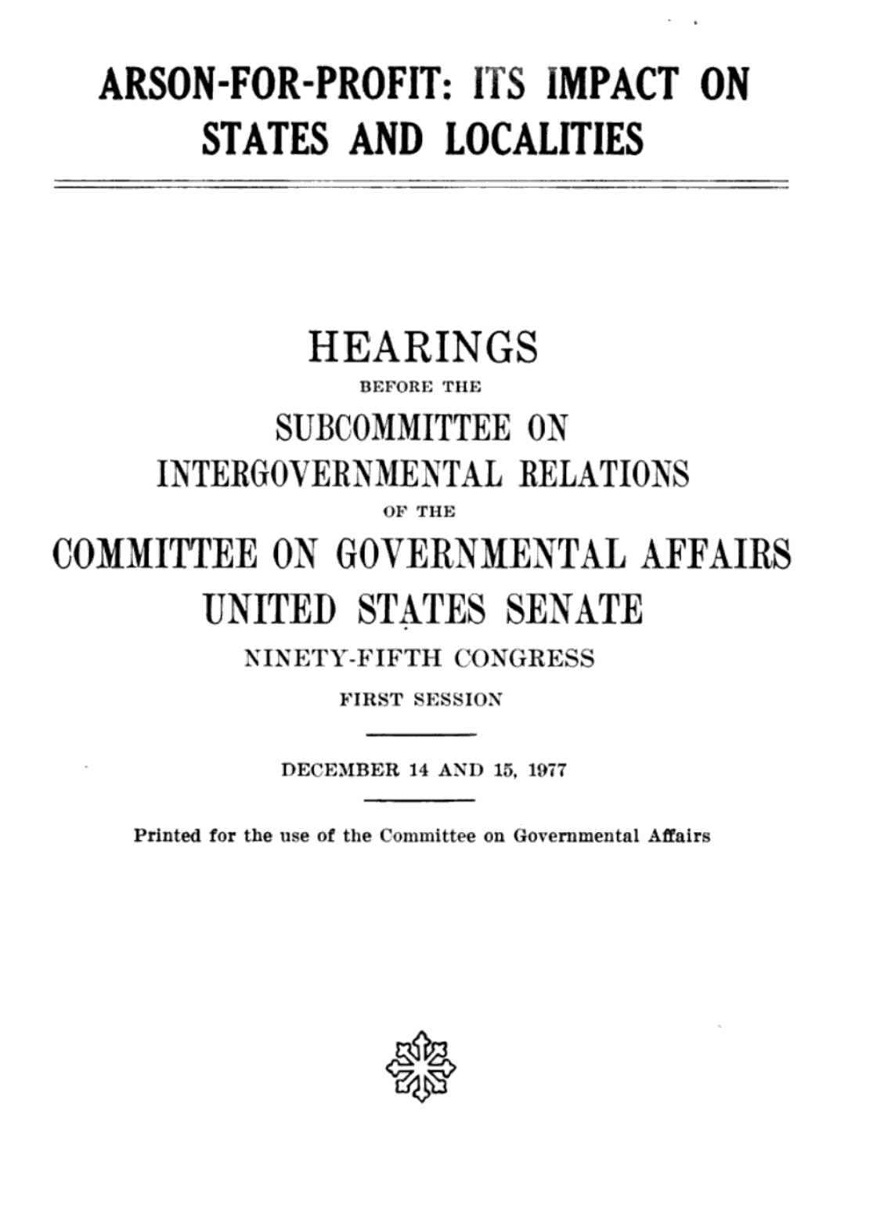
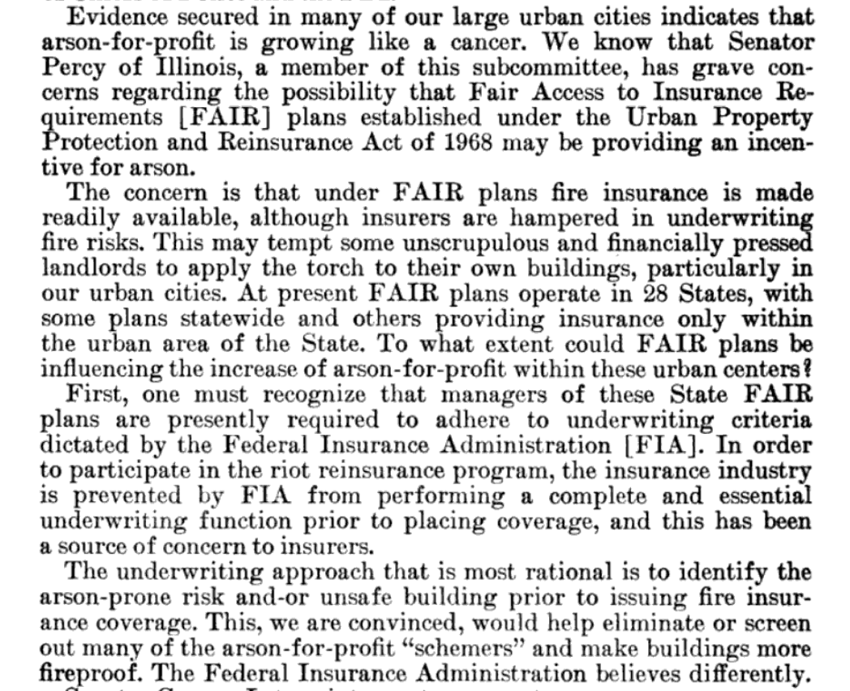
.
.
Notes:
In 1977, concerns were significant enough that Congress held hearings on “arson-for-profit,” noting concerns that FAIR plan insurers were hampered in their ability to underwrite fire risks.
The concern is that under FAIR plans fire insurance is made readily available, although insurers are hampered in underwriting fire risks. This may tempt some unscrupulous landlords to apply the torch to their own buildings, particularly in our urban cities.

Slide 36
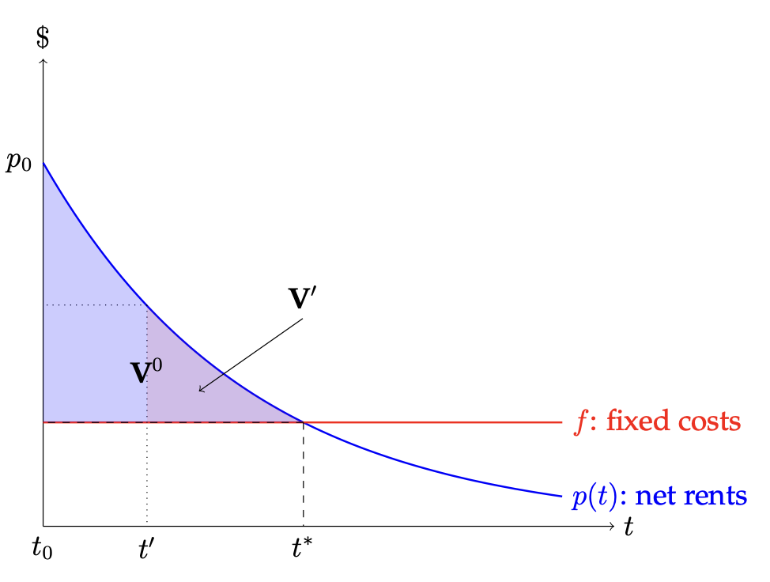
FAIR & Landlord Abandonment
Over-insurance & under-selectivity
FAIR payouts based on replacement costs & underwriting excluded neighborhood factors.
In declining central US cities, replacement costs far exceeded market value.
FAIR sharply increased the benefits of landlord abandonment.
Simple(st) Landlord Problem
Neighborhood decline rules out renovation.
Depreciation determines abandonment.
Over-insurance introduces moral hazard.

Slide 37
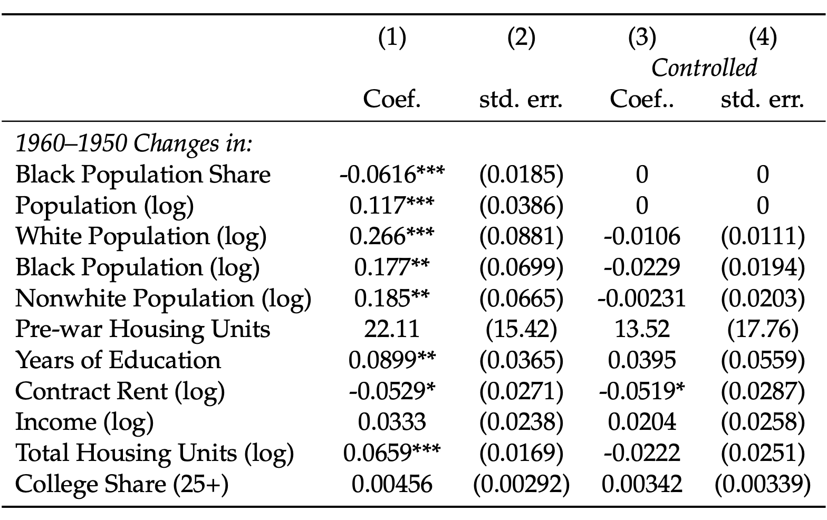
Balance Tests
Notes:
The first column shows the value of the diff in diff– comparison between 1950-1960 pre-trends for eight outcomes for reduced access vs stable access neighborhoods in early FAIR states compared to same difference in late FAIR states. Generally stat tests reject that these differences in pre-trends are zero. But once we control for distance to CBD, and top three variables, we find differences fall substantially and generally lose significance. Conditional on controls, neighborhood contrasts evolved similarly over the pre-treatment period, 1950-60.

Slide 38
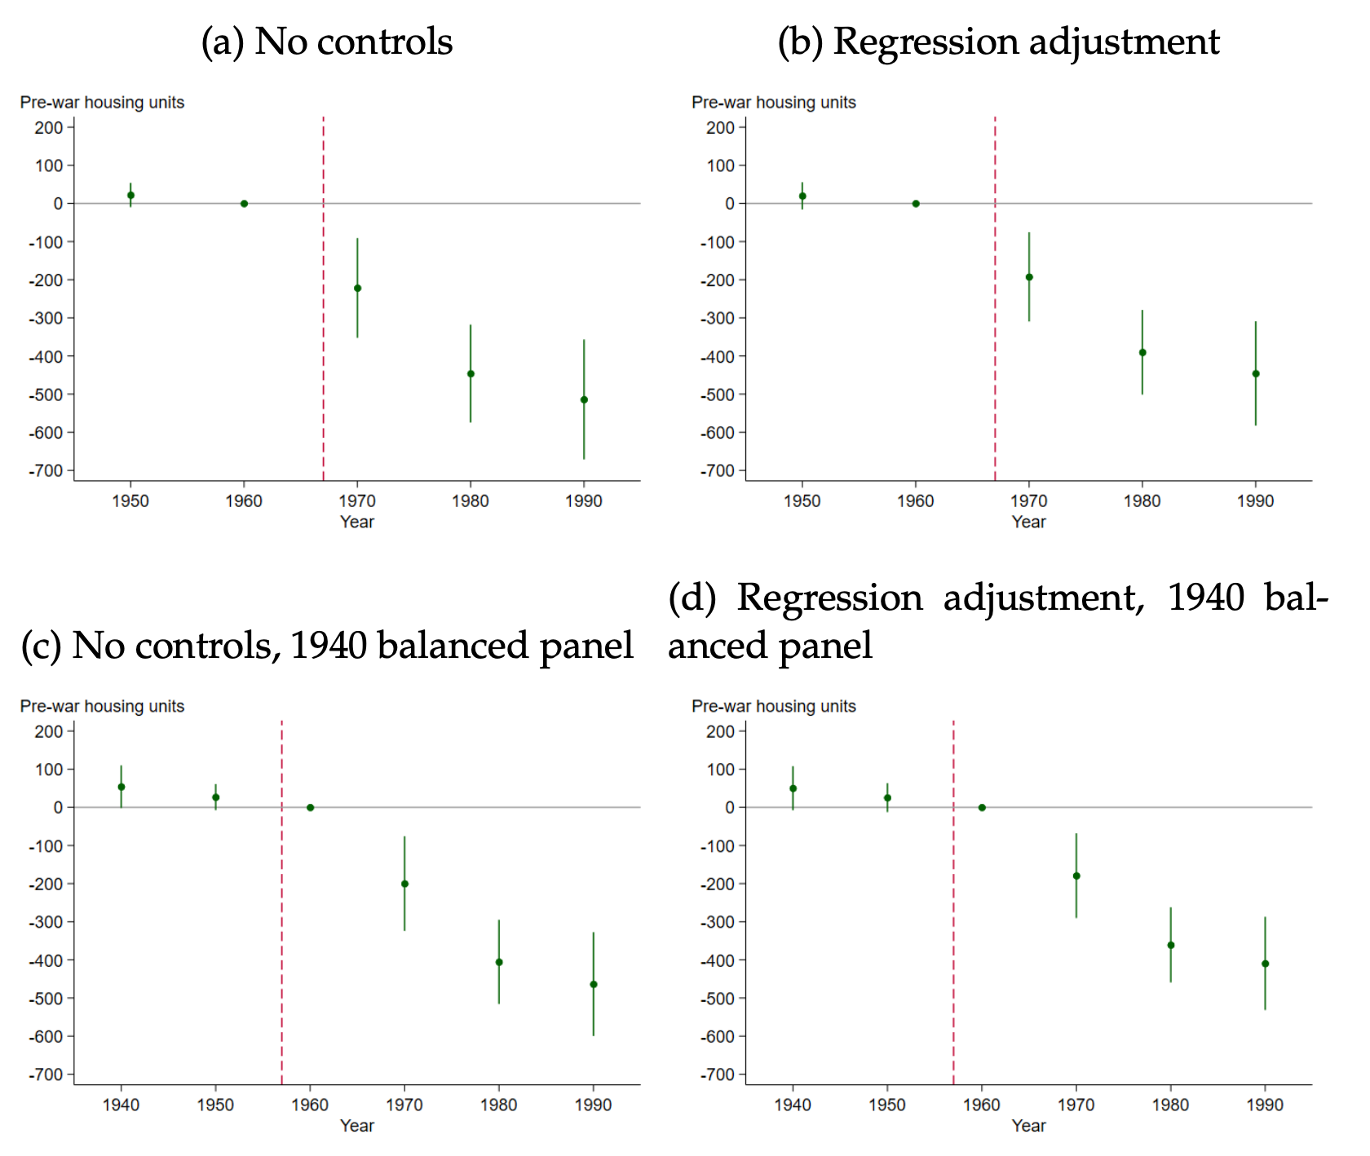
Event Studies

